Slide 1

Calendrify

Slide 2

Introduction
This calendar is a schedule management tool that helps you create, update, and manage schedules for you and your team/group.
Calendar will help or guide user to stay on track and aware user for upcoming deadlines and sprint schedules.
It has responsive design and will show daily , weekly and monthly views updates on your project

Slide 3
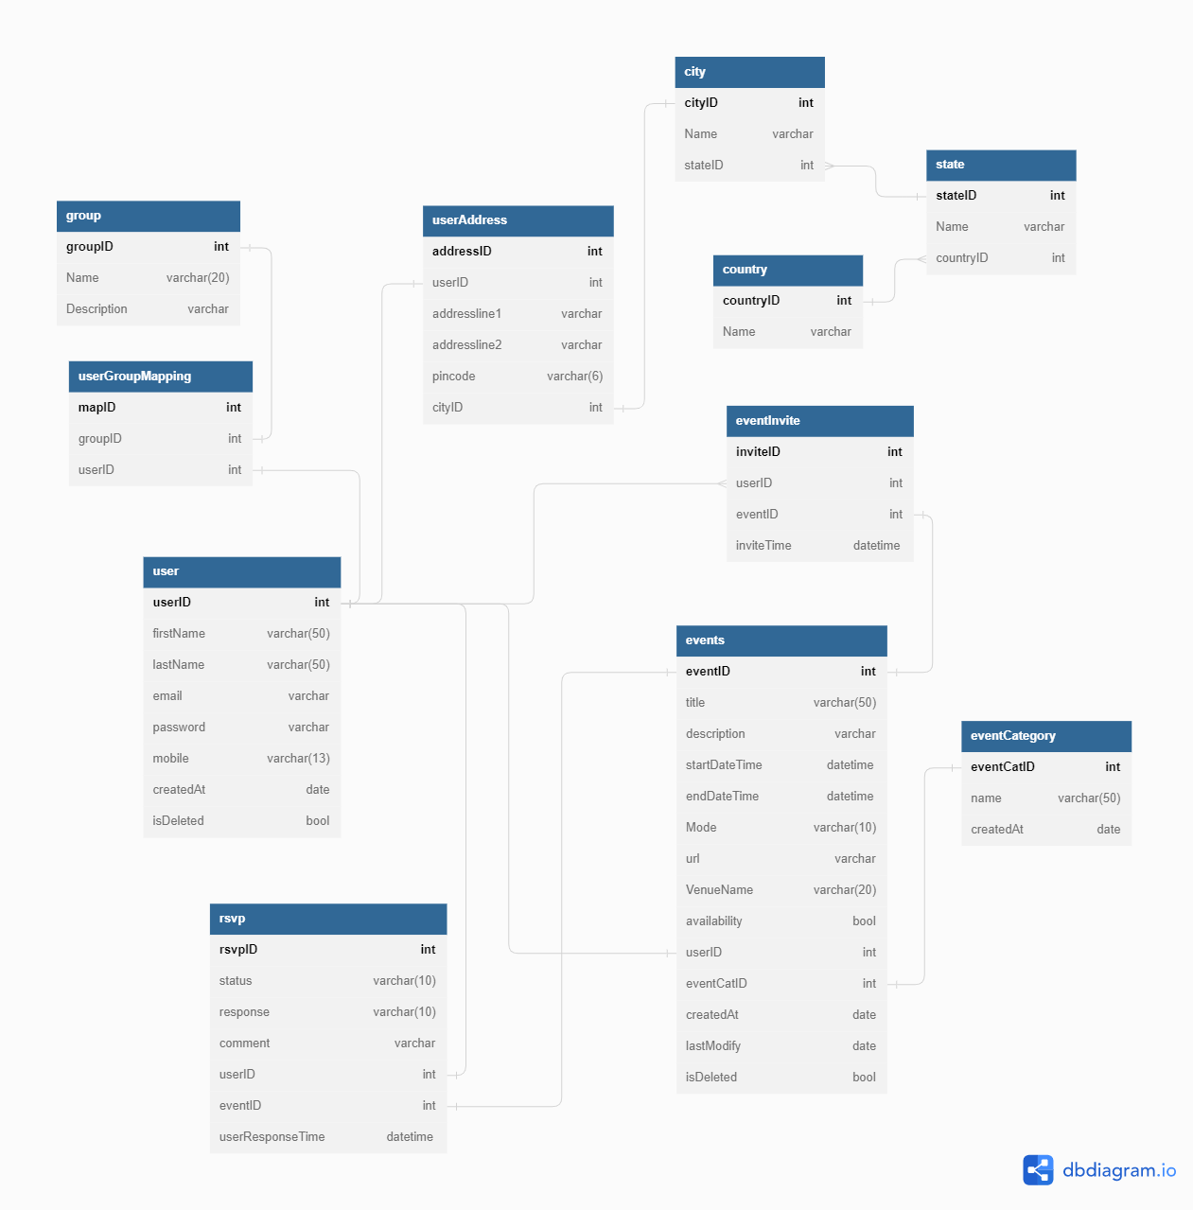

Slide 4
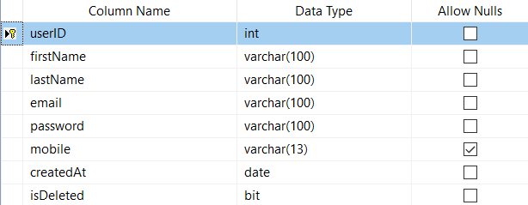
User and userGroup / team registration
User will register first and join group or team accordingly as their requirements

Slide 5
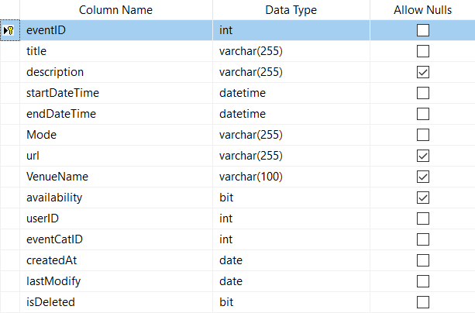
Events and events category
User can create a event or able join a event at time
Events with different category will have start and end time for event with online or offline mode.
If event is organize online then it will provide url for meet or if it is offline it will provide venue for meet or gathering within specific time

Slide 6
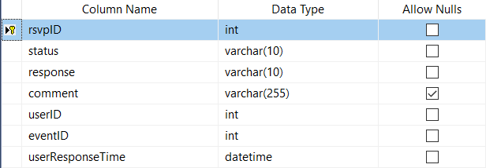
Event Invites and RSVP
User will get invite through calendar for joining a meet or group.
Calendar will remind user after period of time with notification.
User response will be recorded in rsvp table after he/she attend/not attend meet.

Slide 7
Store Procedure
Procedure to find detail of user and events with event-mode (if it’s online or offline)
Procedure to count the total response submitted by user(with yes answer) on events enter by user
Procedure to find event , venue detail with with date/month/year by user
Procedure to list event details with given date enter by user

Slide 8
View and UDF
View for showing upcoming events in future
UDF for count total events in one specific category
UDF for check whether user is available for meet event or not

Slide 9
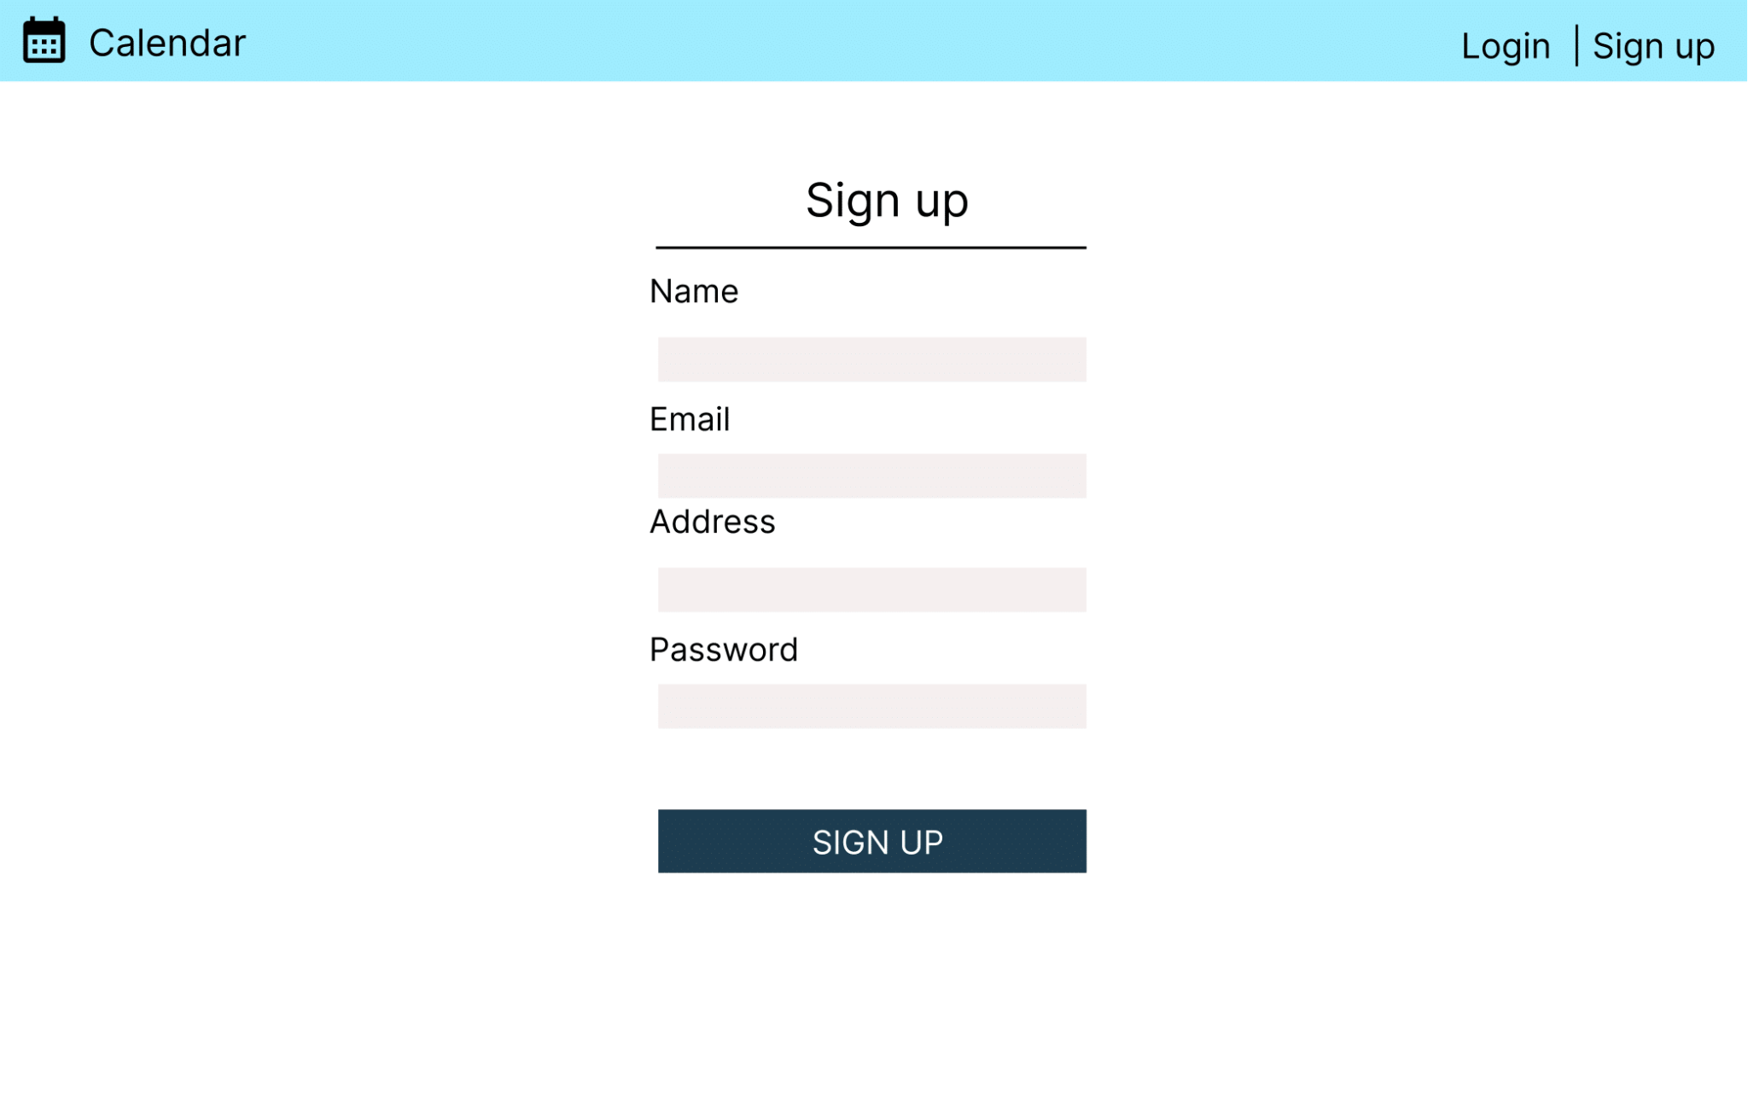
Design

Slide 10
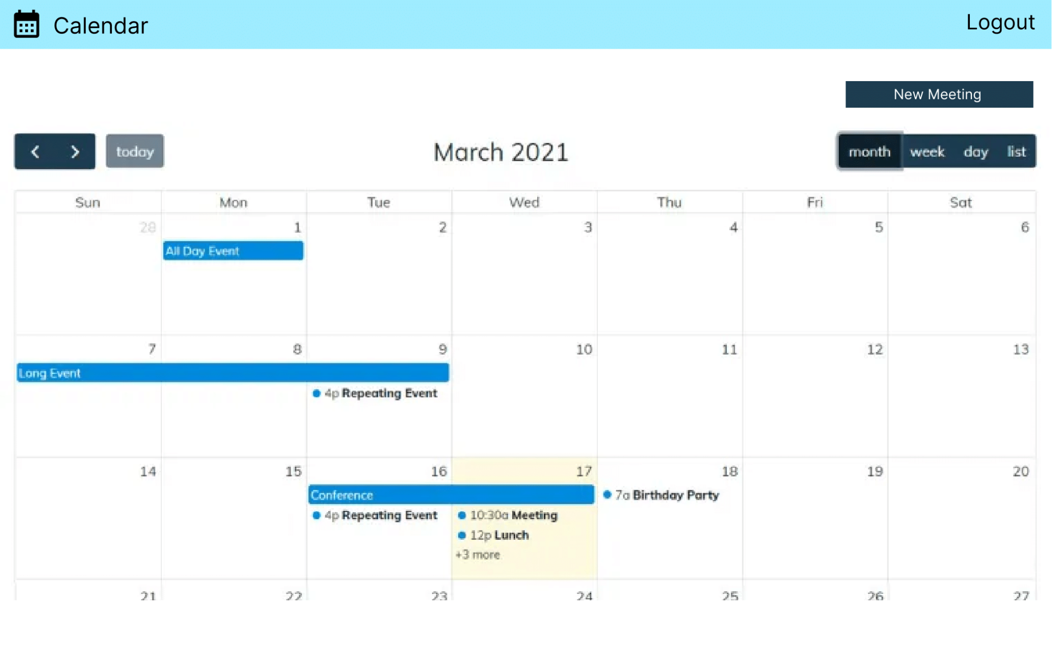

Slide 11
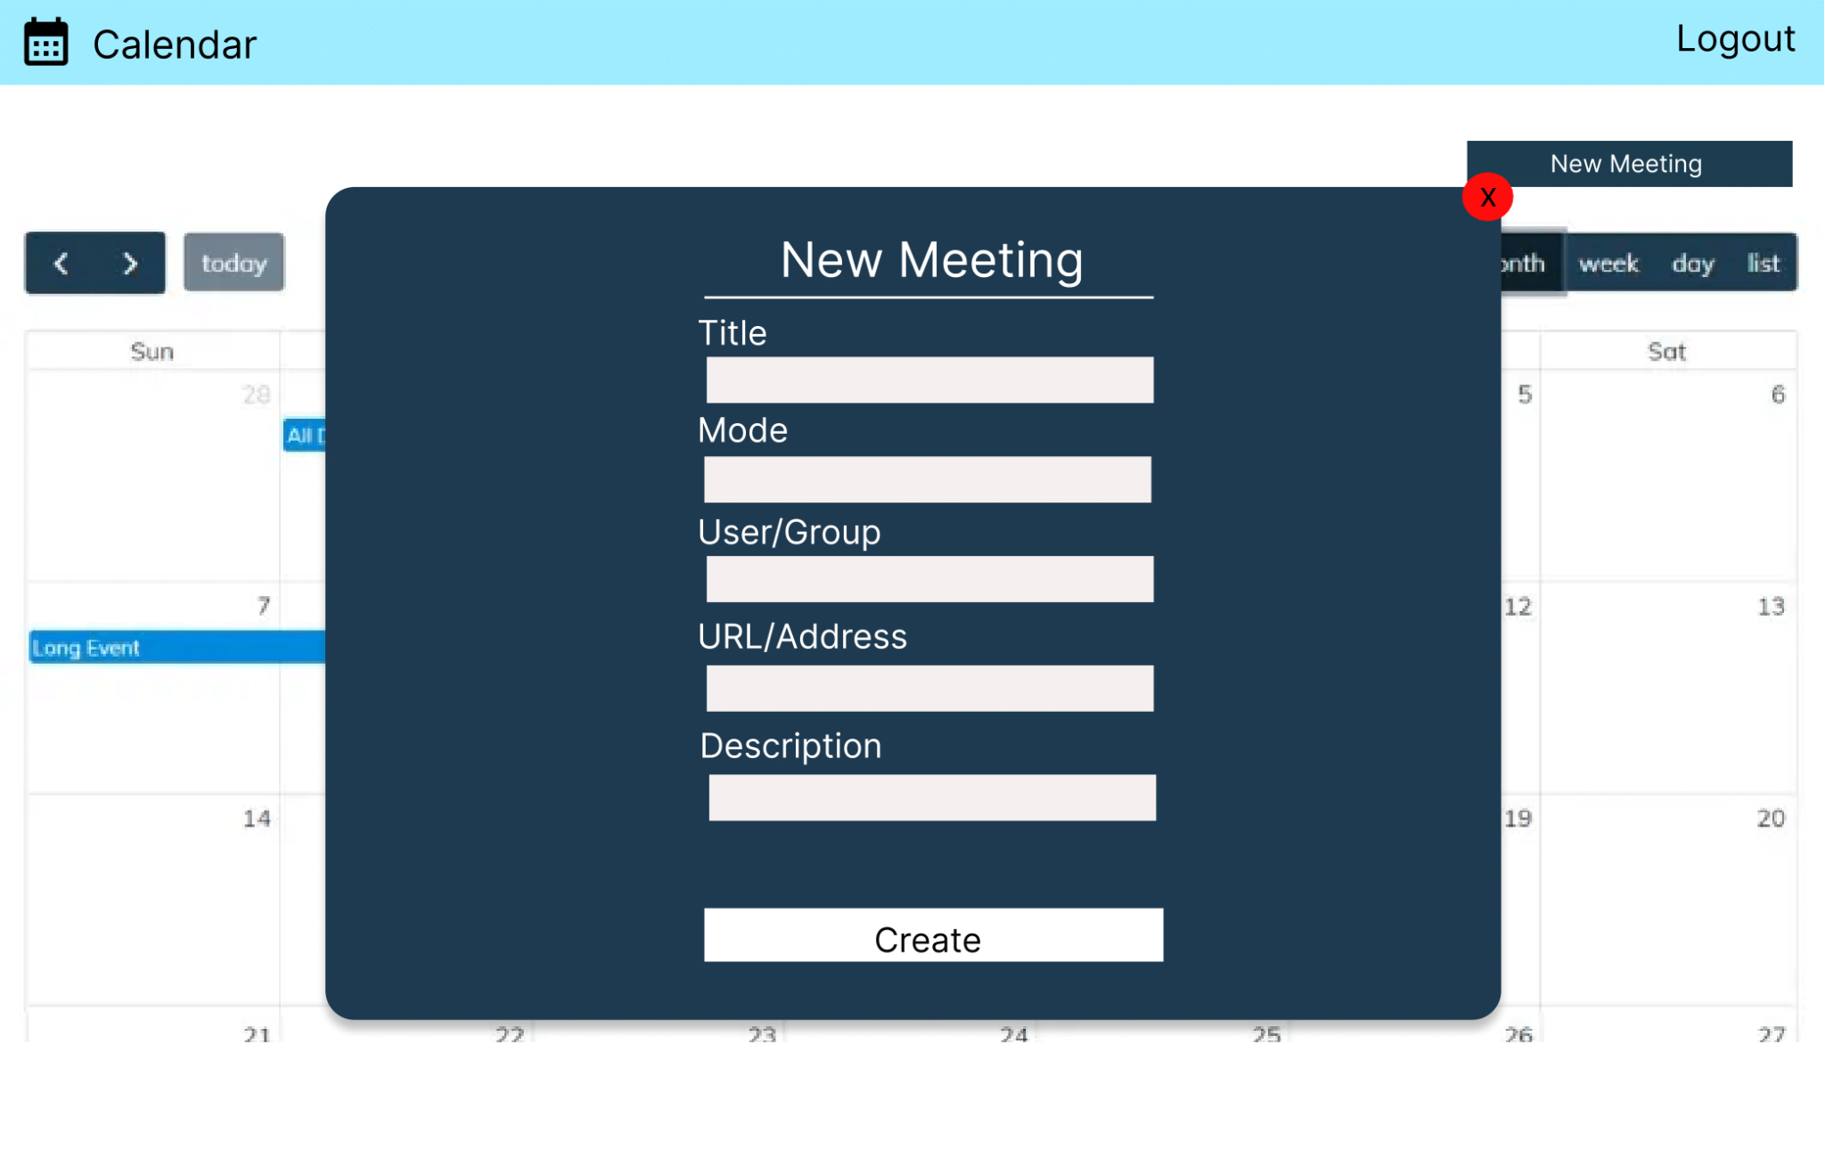

Slide 12
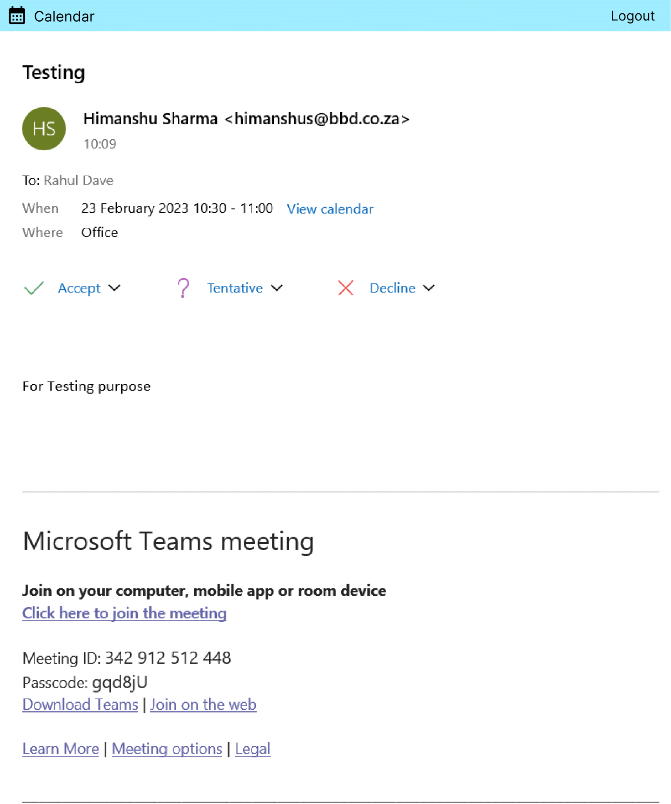

Slide 13
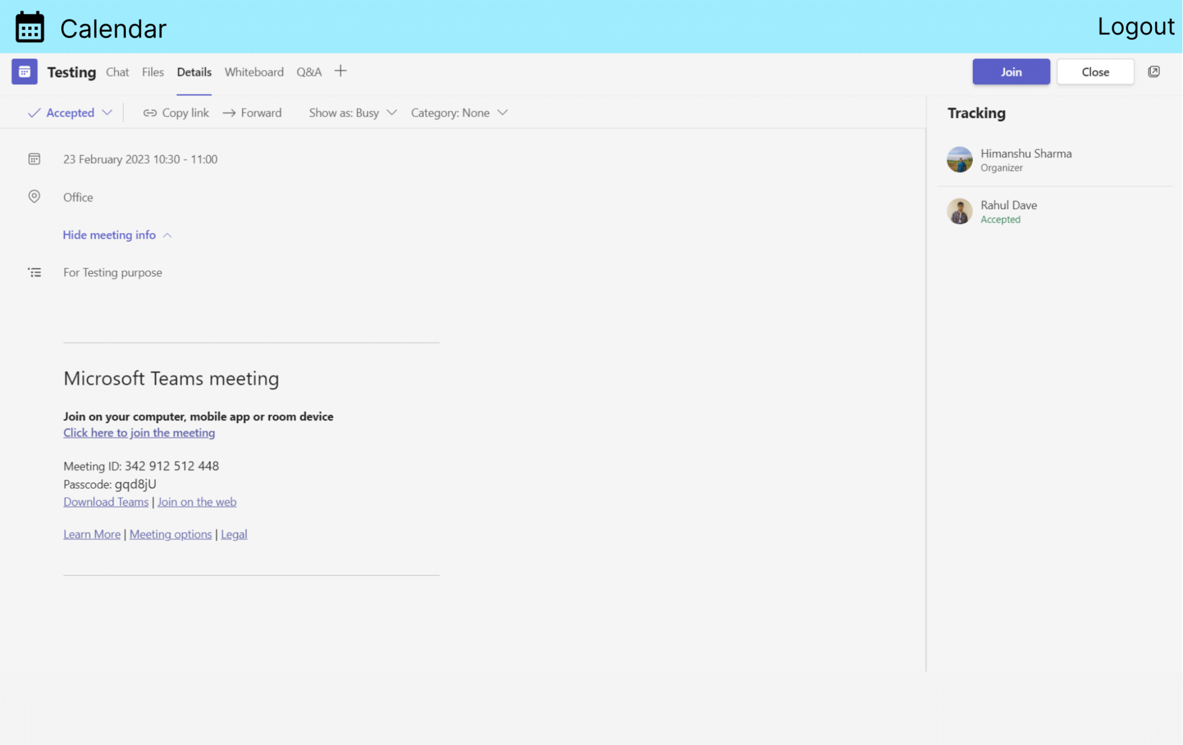

Slide 14
Thank you
-Rahul Dave
-Saurav Kesari
-Himanshu Sharma

